Slide 1

Microsoft Azure Stack Hub Disconnected Scenarios
Special Considerations
This work is licensed under a Creative Commons Attribution - ShareAlike 4.0 International Public License

Slide 2
Agenda
Deployment of a disconnected Azure Stack Hub
Disconnected registration
Disconnected certificate use
Disconnected identity with ADFS
Disconnected time sync
Disconnected marketplace syndication
Disconnected licensing, billing, and consumption reporting
Adjacent systems for identity, monitoring, and management
Disconnected backup
Disconnected support scenarios
Intermittently-connected scenarios

Slide 3
Deployment of a Disconnected Azure Stack Hub
What’s different during deployment

Slide 4
Blah blah
Stuff stuff stuff

Slide 5
Disconnected Registration
An initial task to perform off-stack

Slide 6
Disconnected Certificate Use
PKI considerations

Slide 7
Disconnected Identity with ADFS
You must use AD and ADFS, not AAD

Slide 8
Disconnected Identity with AD FS
Deploy Azure Stack Hub using ADFS
Configure AD FS federation
Configure GraphAPI
AzS is up and running using CloudAdmin
Users are now able to logon using their AD credentials
IAM in AzS now shows Users and Groups from (one) Active Directory
Important
You cannot switch the identity provider without redeploying the entire Azure Stack Hub solution.

Slide 9
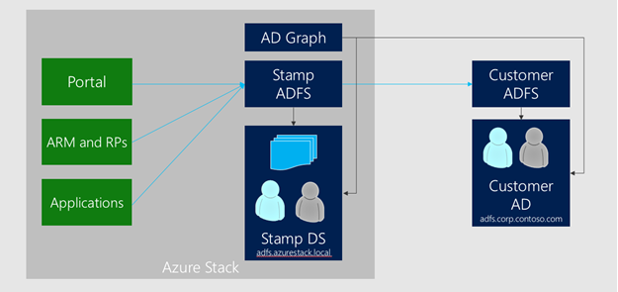
Active Directory Federation Services and Graph
Deploying with AD FS allows identities in an existing Active Directory forest to authenticate with resources in Azure Stack Hub.
This existing Active Directory forest requires a deployment of AD FS to allow the creation of an AD FS federation trust.

Slide 10
Setting up AD FS integration
There are two ways to setup AD FS integration:
Setting up AD FS integration by downloading federation metadata https://docs.microsoft.com/en-us/azure/azure-stack/azure-stack-integrate-identity#setting-up-ad-fs-integration-by-downloading-federation-metadata
Setting up AD FS integration by providing federation metadata file https://docs.microsoft.com/en-us/azure/azure-stack/azure-stack-integrate-identity#setting-up-ad-fs-integration-by-providing-federation-metadata-file
Use b) if either of the following conditions are true:
The certificate chain is different for AD FS compared to all other endpoints in Azure Stack Hub.
There’s no network connectivity to the existing AD FS server from Azure Stack Hub’s AD FS instance.
At the existing AD FS, a relying party trust must be configured. This step is not done by the automation, and must be configured by the operator:
Configure relying party on existing AD FS deployment https://docs.microsoft.com/en-us/azure/azure-stack/azure-stack-integrate-identity#configure-relying-party-on-existing-ad-fs-deployment-account-sts

Slide 11
What is Graph?
Authentication (via AD FS) is one part of identity.
To manage Role Based Access Control (RBAC) in Azure Stack Hub, the Graph component must be configured.
Graph
When access to a resource is delegated, the Graph component looks up the user account in the existing AD forest using the LDAP protocol.
Graph only supports integration with a single AD forest. If multiple forests exist, only the forest specified in the configuration will be used to fetch users and groups.

Slide 12
Requirements and Tasks
AD FS
At the existing AD FS, a relying party trust must be configured. This step is not done by the automation, and must be configured by the operator.
Graph
For the Graph configuration, a service account must be provided that has Read permission in the existing Active Directory. This account is required as input for the automation to enable RBAC scenarios.
Component | Requirement
Graph | Microsoft Active Directory 2012/2012 R2/2016
AD FS | Windows Server 2012/2012 R2/2016

Slide 13
Graph Ports
Graph service in Azure Stack Hub uses the following protocols and ports to communicate with the target Active Directory:
Type | Network | Port | Protocol
LDAP | Public VIP | 389 | TCP & UDP
LDAP SSL | Public VIP | 636 | TCP
LDAP GC | Public VIP | 3268 | TCP
LDAP GC SSL | Public VIP | 3269 | TCP

Slide 14
Additional Information
Graph protocols and ports https://docs.microsoft.com/en-us/azure/azure-stack/azure-stack-integrate-identity#graph-protocols-and-ports

Slide 15
Disconnected Time Sync
To NTP, or not to NTP

Slide 16
Disconnected Marketplace Syndication
Keeping the marketplace fresh while offline

Slide 17
Disconnected Marketplace Syndication
How to download marketplace items?
Use PowerShell and the marketplace syndication tool to download the marketplace items to a machine with internet connectivity.
You then transfer the items to your Azure Stack Hub environment.
In a disconnected environment, you cannot download marketplace items by using the Azure Stack Hub portal.

Slide 18
Disconnected Licensing, Billing, and Consumption Reporting
Many aspects of paying for Azure Stack Hub

Slide 19
Adjacent Systems for Identity, Monitoring, and Management
Connecting to other local ‘stuff’

Slide 20
Disconnected Licensing, Billing, and Consumption Reporting
Many aspects of paying for Azure Stack Hub

Slide 21
Disconnected Backup
Backing up the infrastructure or user workloads when disconnected or intermittently connected

Slide 22
Disconnected Support Scenarios
Troubleshooting a disconnected Stack

Slide 23
Intermittently-Connected Scenarios
What’s different if you can be connected sometimes?

Slide 24

How often does Azure Stack Hub need to connect?
The licensing terms for a ‘connected’ Azure Stack Hub state that it must connect for billing purposes at least once every 30 days

Slide 25
Questions?

Slide 27
Appendix

